Slide 1
TxDOT Pavement Manual
http://onlinemanuals.txdot.gov/txdotmanuals/pdm/pdm.pdf
TxDOT Specifications (Item 360)
https://www.txdot.gov/inside-txdot/division/construction/txdot-specifications.html
TxDOT Roadway Standards
https://www.txdot.gov/insdtdot/orgchart/cmd/cserve/standard/rdwylse.htm

Slide 2
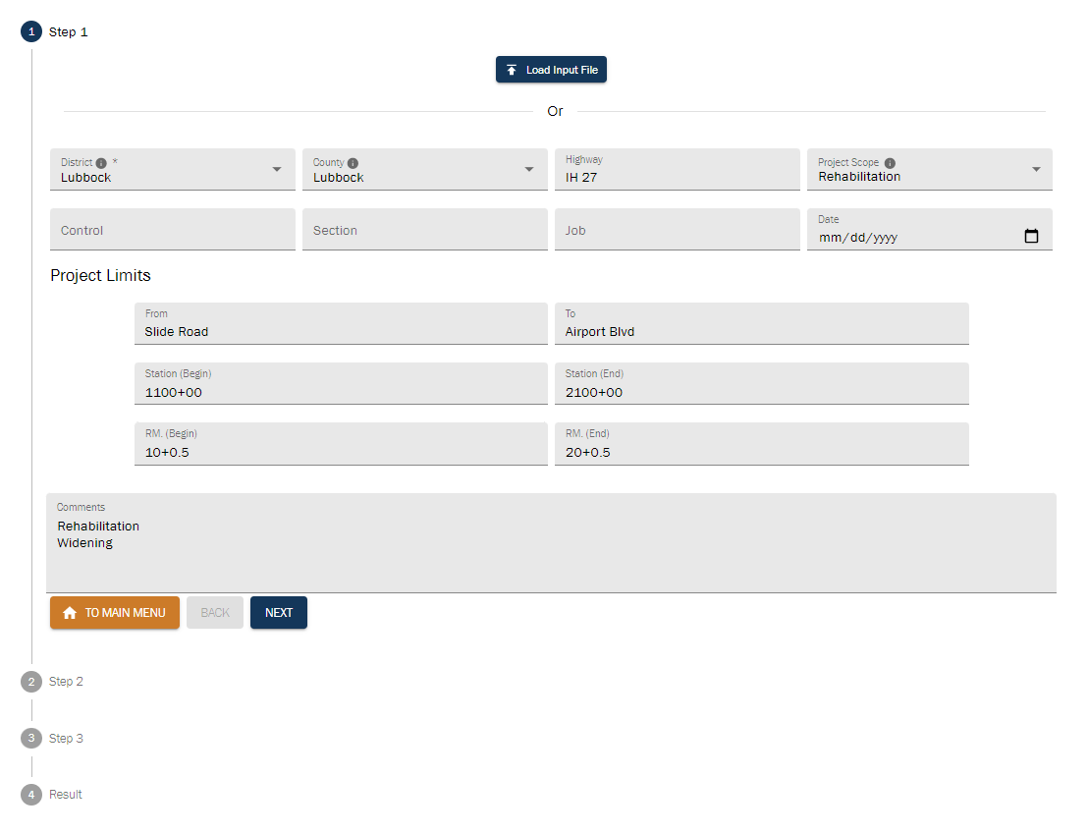
TxDOT Pavement Manual
TxDOT Specifications
TxDOT Roadway Standards

Slide 3
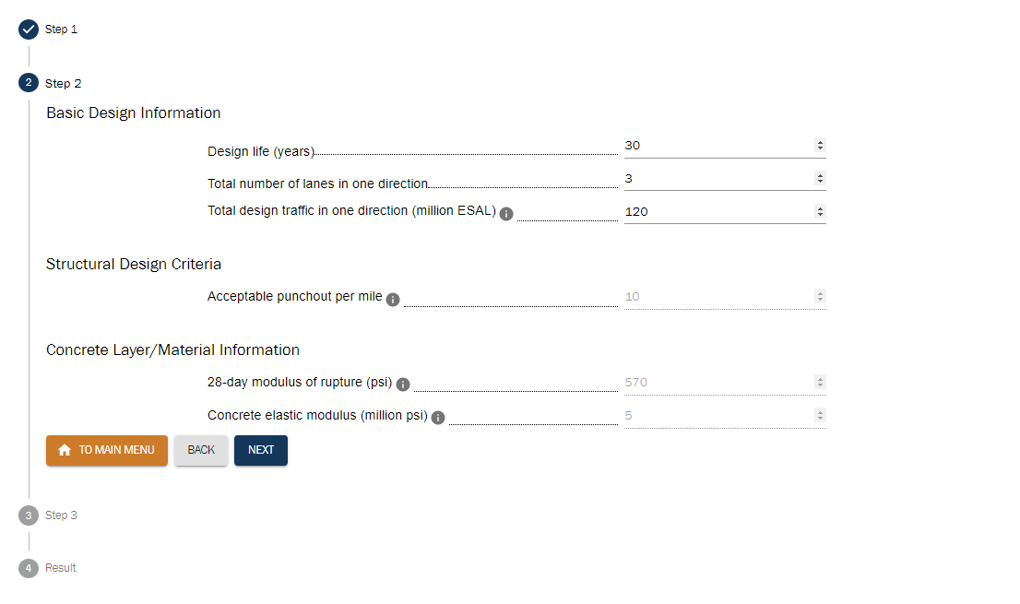
TxDOT Pavement Manual
TxDOT Specifications
TxDOT Roadway Standards

Slide 4
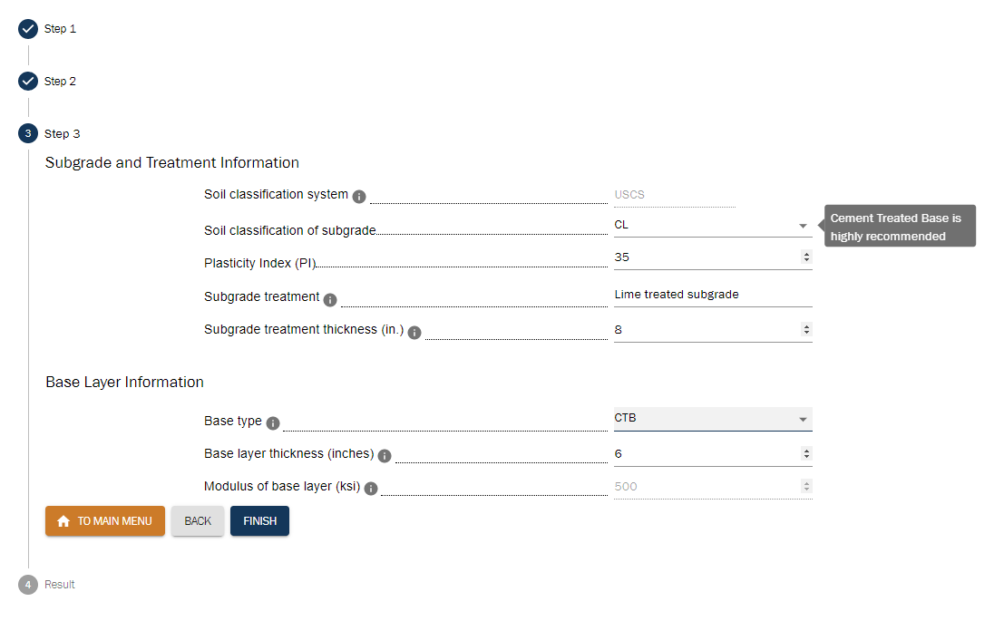
TxDOT Pavement Manual
TxDOT Specifications
TxDOT Roadway Standards

Slide 5
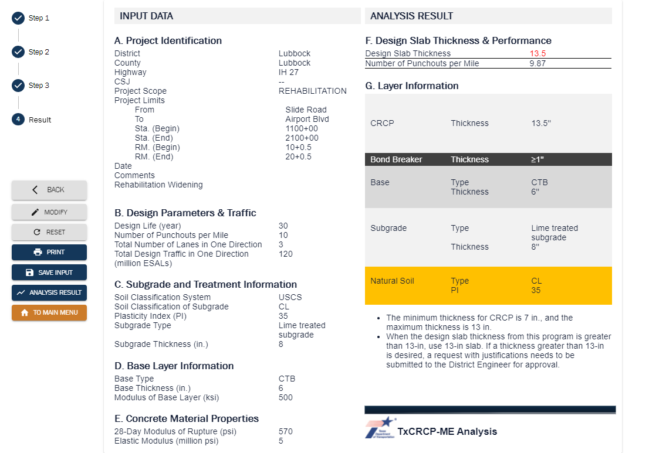
TxDOT Pavement Manual
TxDOT Specifications
TxDOT Roadway Standards

